Slide 1
Economics

Slide 2
ECONOMICS – is a social science that deals with how people organize themselves in order to allocate scarce resources in order to produce goods and services that will satisfy the unlimited and multiplying wants and needs of man
Economics is the social science that studies how people interact with value; in particular, the production, distribution, and consumption of good and services

Slide 3
The study of how individuals and societies choose to allocate and use scarce resources to satisfy unlimited wants.
Embedded in the definition are four key words:
Choice
Resource Allocation
Scarcity
Unlimited Wants

Slide 4
Concerns of Economics
Economics is concerned with PRODUCTION
Production is the use of inputs to produce outputs.
Inputs are commodities or services that are used to produce goods and services.
Outputs are the different goods and services which come out of production process.
Society have to decide what outputs will be produced and in what quantity

Slide 5
Types of economics
Micro economics
Macro economics

Slide 6
Micro economics
Micro has been derived from Greek word “ MIKROS” which mean small .
It is a study of the individual units of economic system .
In other words a small part of economy & not the whole economy
Micro economics is a study of the specific economic units and a detailed consideration of the behaviour of these individual units ”
“Micro economics seeks to explain the working of individuals, firms ,households, Individual prices ,Wages, particular industries ”

Slide 7
Macro economics
Macro is been derived from the Greek word “ MAKROS ”which means LARGE .
Macro economic is the study of large part of the economy ie, The whole economy.
The study of economic behaviour of the economy as a whole & not the individual economic units of the economy.
“ Marco economics deals not only with individual quantities but with the aggregates of these quantities , not with the individual incomes , but with national income , not with individual prices , but with prices level , not with individual outputs but with the national output ”

Slide 8
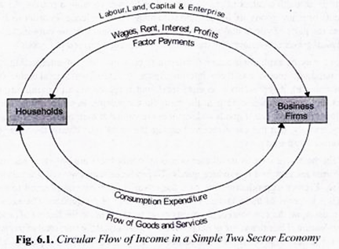
Circular flow of income

Slide 9
The term circular flow of income or circular flow of economic activity refers to a simple economic model which describes the circulation/flow of income between producers and consumers.
• In the circular flow model, producer is referred to as firms and consumer are referred to as households.
• The major exchanges are represented as flows of money, goods and services, etc.

Slide 10
Household
It is a person or group of people that share their income.
• Require goods and services to satisfy their personal wants.
• Owns all resources ( i.e. labor, capital, land enterprise)
• The members of households have two functions.
1. They supply different factors of production.
2. Members of household also work as consumers.

Slide 11
Firms
• An organization that produces goods and services for sale.
• Main objective is to maximize profit in the production process
• Uses resources provided by households to produces goods and services
• Sells those good and services for income
• The two main functions are as follows:
Produce goods and service and supply them in the market
2. Firms purchase inputs or raw materials from households to use them in the production process.

